Slide 1
Won’t work on google slide viewer – needs to be downloaded and run on PowerPoint!
Please make sure you are using latest version, downloaded from https://bit.ly/2ZwnjEH
Please don’t share slides by email but direct people to the link

Slide 2
This version is for teens aged around 14-18

Slide 3
WELCOME TO
PROTECTING OUR PLANET
(AND WHAT WE CAN DO)
Notes:
Speaker introduces themselves and explains why they are here
The aim of the talk is to explain what is meant by the “climate crisis” or “ecological crisis”, what that means for us globally as well as here in the UK, and what we can do about it.
If you want to find out more after the talk then please visit www.scientistsforxr.earth or https://actionnetwork.org/forms/join-the-xr-youth-network-2

Slide 4
Aims of this talk
PART 1
THE PLANETARY PROBLEM
PART 2
WHAT WE NEED TO DO
Notes:
There are two parts to the this talk. In the first part we’ll be looking at what we’re calling here the “planetary problem” – some people call it the “climate crisis” but as we will see, it is about more than just climate. It’s about the fact that we as humans have been living our lives freely without thinking about the long-term consequences of our lifestyles on the health of our planet. This is now starting to cause problems, and we will look at what those are and then at what we can do.
The first part of the talk can be quite worrying but the second part of the talk shows that it is not too late to take action to keep the planet healthy. However time is running out, and we need a large-scale change in how we run our lives. The second part of the talk will look at what those changes need to be, and how we can work together to make them happen.

Slide 5
Aims of this talk
PART 1
THE PLANETARY PROBLEM
Notes:
There are two parts to the this talk. In the first part we’ll be looking at what we’re calling here the “planetary problem” – some people call it the “climate crisis” but as we will see, it is about more than just climate. It’s about the fact that we as humans have been living our lives freely without thinking about the long-term consequences of our lifestyles on the health of our planet. This is now starting to cause problems, and we will look at what those are and then at what we can do.
The first part of the talk can be quite worrying but the second part of the talk shows that it is not too late to take action to keep the planet healthy. However time is running out, and we need a large-scale change in how we run our lives. The second part of the talk will look at what those changes need to be, and how we can work together to make them happen.

Slide 6

We depend on it for our survival
The earth is our only life support system
We depend on its climate
We depend on its ecology
Notes:
Let’s start by remembering that the Earth is our only life support system. We depend on it for our survival.
We depend on its climate. Climate means how warm or cold it is in a particular part of the Earth, or perhaps the whole Earth, over a long time. Note that climate is not the same as weather – weather means what is happening right here and now – is it a hot day or a cold day, is it raining etc. Some people liken climate to temperament and weather to mood – just like you can have a generally cheerful temperament but be in a bad mood, similarly you can have a warm climate but have an unusually cold day. Climate makes certain kinds of weather more likely however.
We also depend on Earth’s ecology. Ecology means the web of living things that co-exist and support each other in a balanced way – some creatures make oxygen, some absorb it, some produce food etc. We depend on the current ecology to produce our food and regulate the balance of the atmosphere.
Both climate and ecology and under threat from our current activities.

Slide 7
We depend on it for our survival
The earth is our only life support system
We depend on its climate
Both of these are in trouble!
We depend on its ecology
Notes:
Let’s start by remembering that the Earth is our only life support system. We depend on it for our survival.
We depend on its climate. Climate means how warm or cold it is in a particular part of the Earth, or perhaps the whole Earth, over a long time. Note that climate is not the same as weather – weather means what is happening right here and now – is it a hot day or a cold day, is it raining etc. Some people liken climate to temperament and weather to mood – just like you can have a generally cheerful temperament but be in a bad mood, similarly you can have a warm climate but have an unusually cold day. Climate makes certain kinds of weather more likely however.
We also depend on Earth’s ecology. Ecology means the web of living things that co-exist and support each other in a balanced way – some creatures make oxygen, some absorb it, some produce food etc. We depend on the current ecology to produce our food and regulate the balance of the atmosphere.
Both climate and ecology and under threat from our current activities.

Slide 8
First let’s look at climate
Notes:
First, let’s look at climate.

Slide 9
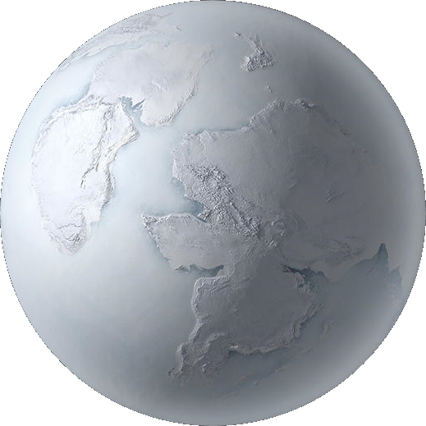
What stops us being a ball of ice?
Notes:
What stops us from being a ball of ice?
The Earth is floating in space, and space is extremely cold – only a few degrees above absolute zero which is as cold as things can possibly get – so the Earth on its own would be a ball of ice.

Slide 10
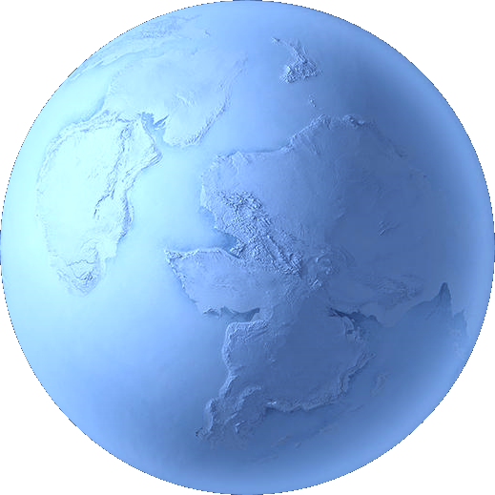
What stops us being a ball of ice?
SUN
The sun’s energy warms us
Notes:
However, we orbit the sun, and the sun’s rays reach the Earth and warm it.
[For more detail]
The sun’s energy reaches us as visible light, and when it reaches the Earth this light energy is absorbed and converted into heat. This heat then radiates back out away from the Earth in the form of lower-frequency infrared radiation, or “heat”. If we had no atmosphere, this radiation would escape back out into space and the Earth would be very much colder than it is now – not absolute zero, but it would certainly be a ball of ice.

Slide 11








What stops us being a ball of ice?
Carbon dioxide (CO₂) in the atmosphere traps the heat (greenhouse effect) and keeps the climate temperate
SUN
The sun’s energy warms us
Water remains
mostly liquid
and life can flourish
Notes:
Fortunately, we have an atmosphere that contains carbon dioxide (CO₂) which has the property that even in very tiny amounts, it traps heat and stops it from escaping back out into space. This heat-trapping is called the greenhouse effect and it is what keeps the climate temperate. (note that CO₂ isn’t the only greenhouse gas, but it is the main one of concern at the moment).
Because of the balance between energy coming in and energy escaping back out again, regulated by greenhouse gases, the Earth’s climate is temperate and so water remains mostly liquid (except for the ice at the poles and water vapour in the atmosphere) and life is able to flourish.
[For more detail]
Around 200 years ago the French physicist Joseph Fourier (some of you may recognize his name from Fourier analysis) calculated that the Earth is warmer than would be expected given how much energy reaches us from the Sun and how much in theory radiates back out into space. In the mid-1900s the geologist John Tyndall suggested that the composition of the atmosphere might regulate temperate, and found that water vapour, CO₂ and methane are heat-trapping.
Here is an interesting article about the discovery of the greenhouse effect:
https://www.irishtimes.com/news/science/how-joseph-fourier-discovered-the-greenhouse-effect-1.3824189

Slide 12

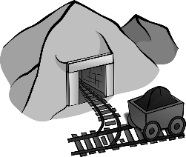




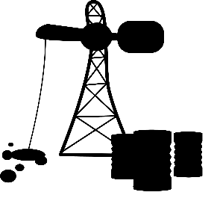


Around 150 years ago the industrial revolution began
Coal
Oil
Gas
Fossils
Fossil fuels
Machines
Notes:
In the mid-1800s, scientists and engineers began to develop the first fuel-powered machines. Before then, energy from the wind and from water was used to drive machines but with the development of the steam engine, attention switched to coal, and then oil and natural gas. These are fossil fuels, called that because they arise from the decayed remains of ancient plants and animals that were buried in the Earth and then slowly turned into fuel.
Fossil fuels are abundant in the earth’s crust and for 200 years, we have been digging out coal, and drilling for oil and natural gas, so that we can power more and more machines. This led to what we call the “Industrial Revolution”. Nowdays, in the industrialised parts of the world such as the UK, Europe and America, most of our activities use fossil-fuel-powered machines. We drive around in cars, burn gas to heat our homes, burn aviation fuel to go on holiday, and we eat very large amounts of meat, which require a lot of fossil fuel to produce and transport.
There is one very big consequence of all this fossil fuel burning and that is that its major byproduct is CO₂.
[For more advanced discussion]
In the 1890s the Swedish chemist Svante Arrhenius calculated that the amount of CO₂ being produced by the activities of industry could, in theory alter the CO₂ composition of the atmosphere enough to trap heat. At that time scientists did not have the tools to test his theory but in the early decades of the 20th century, measurements of the Earth’s temperature and of atmospheric CO₂ began, and it slowly became clear that this was indeed the case.

Slide 13

In burning fossil fuels we have been pouring CO₂ into the air and the Earth is getting hotter – enhancing the greenhouse effect
SUN
Notes:
A major consequence of the Industrial Revolution is that we have been pouring CO₂ into the atmosphere and this is trapping heat, enhancing the greenhouse effect and causing the earth to slowly get hotter.

Slide 14
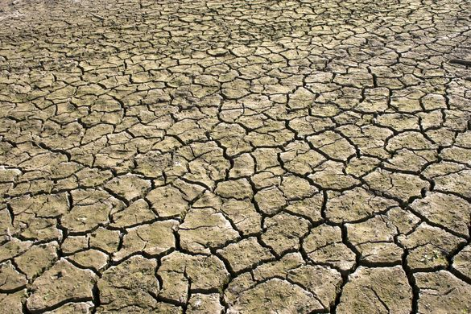
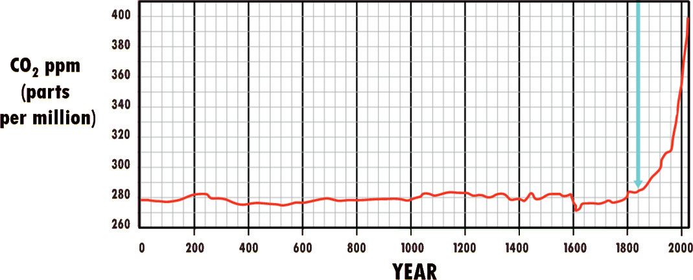
Greenhouse gas levels are skyrocketing
Industrial age began
Graph adapted from https://nas-sites.org/americasclimatechoices/more-resources-on-climate-change
Notes:
This graph shows how fast CO₂ is rising, according to scientific measurements of what happened in the past and what is happening today. CO₂ is only a tiny part of the atmosphere and so is measured in parts per million (ppm), and you can see that for the last 2000 years the level has been pretty stable at around 280 ppm.
However, when the Industrial Revolution began, this level began to rise steeply, and we are now at more than 400 ppm and rising fast.
This graph is sometimes called the hockey stick curve because of the steep bend at the end, like a hockey stick.
Info
Mann ME, Bradley RS, Hughes MK (1999) Northern hemisphere temperatures during the past millennium : inferences, uncertainties, and limitations. Geophys Res Lett 26:759–762. pdf

Slide 15
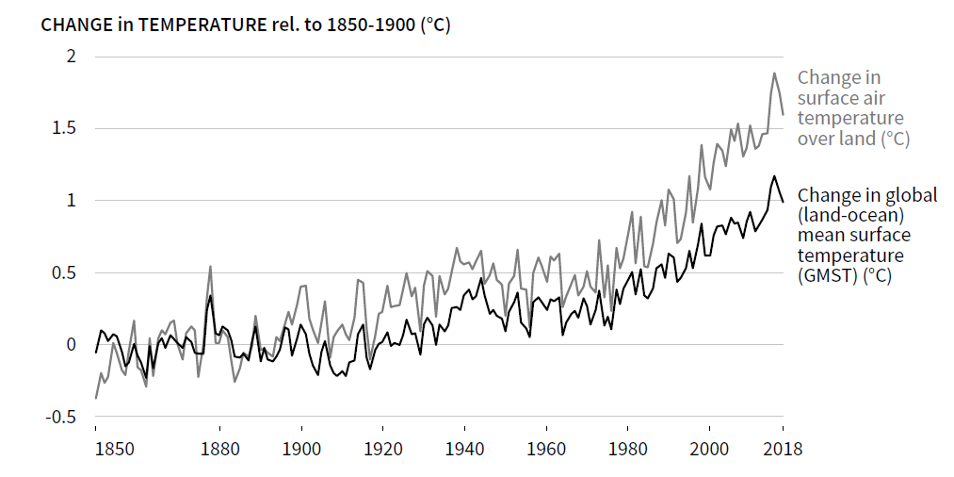
This is how fast Earth’s temperature is rising
Industrial age began
Source: IPCC Special report Climate change and land use (2019)
Notes:
This graph shows what is happening to the earth’s temperature. It is zoomed in on the past 150-odd years from the beginning of the Industrial Revolution, and one curve shows air temperature and one curve shows water temperature – the effect is the same; both are rising fast.
Info
Source: IPCC Special report Climate change and land use (2019)

Slide 16
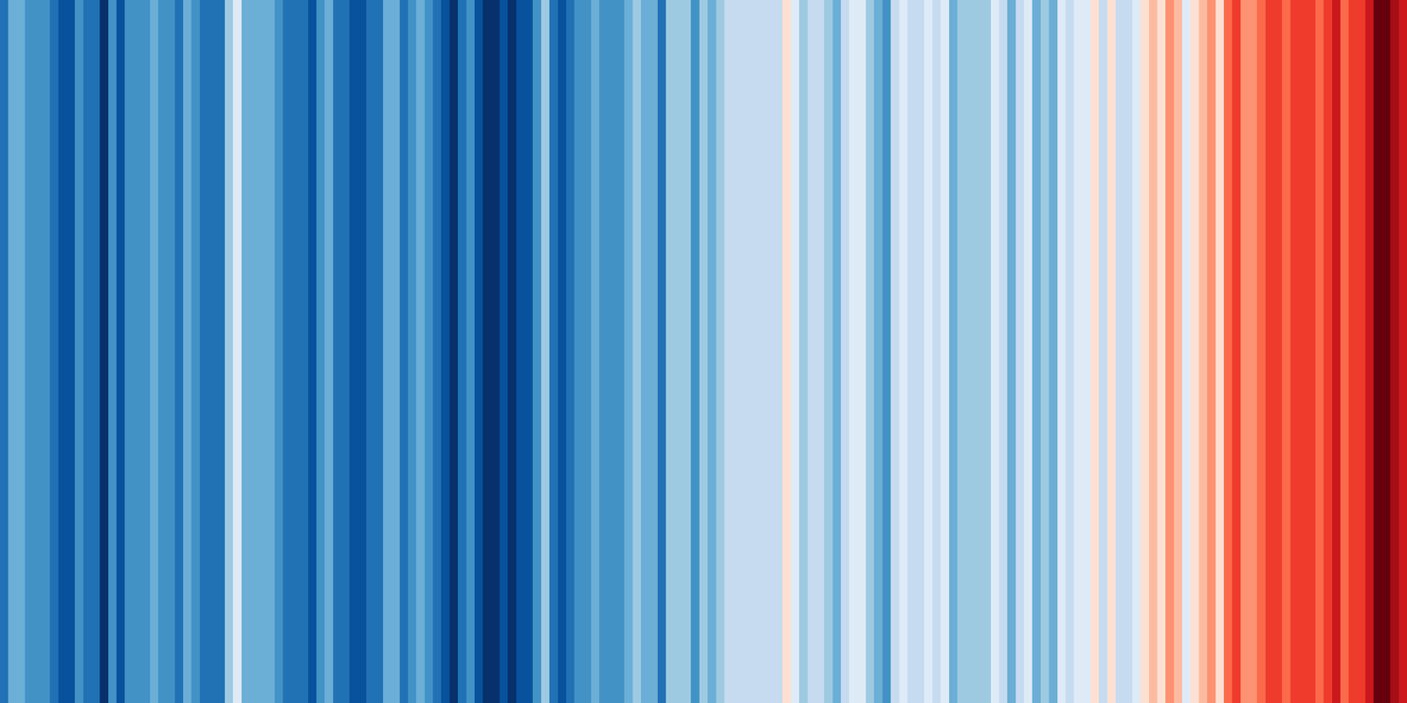
“Warming stripes” 1850-2017
by Ed Hawkins
Cold
Hot
Notes:
[Could be hidden if time is tight – right click on the slide in the summary at the left and select “hide slide”]
Here is a visual image by the climate scentist Ed Hawkins showing the warming effect over time between 1850 (left) and 2017 (right). Each stripe represents global temperature for that year, relative to the pre-industrial baseline. This image has become iconic and is often used as art and fashion.

Slide 17
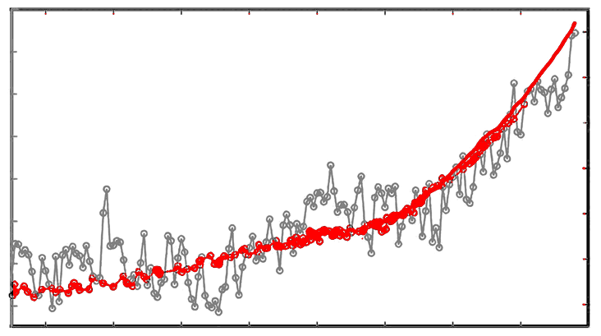
Temperature and CO₂ are rising together
1.2
400
1.0
Global temperature
380
0.8
CO₂
360
ºC
0.6
CO₂
0.4
340
0.2
320
0.0
300
-0.2
280
1860
1900
1940
1980
2020
Adapted from Henley and Abram, http://tiny.cc/tdqeez
Notes:
[Could be hidden if time is tight – right click on the slide in the summary at the left and select “hide slide”]
This shows what happens when you put the temperature and CO₂ curves together – both are rising extremely steeply.
Info
Adapted from Henley and Abram, http://tiny.cc/tdqeez

Slide 18
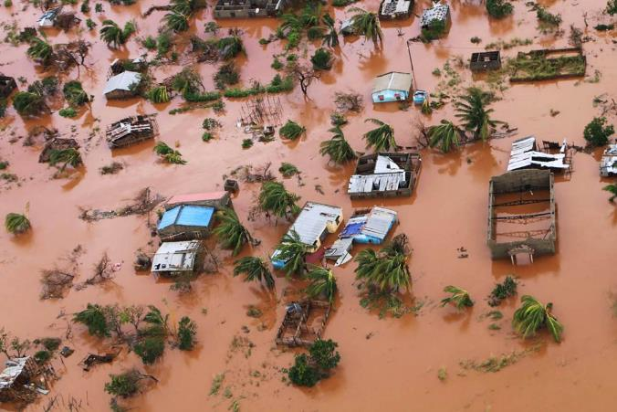
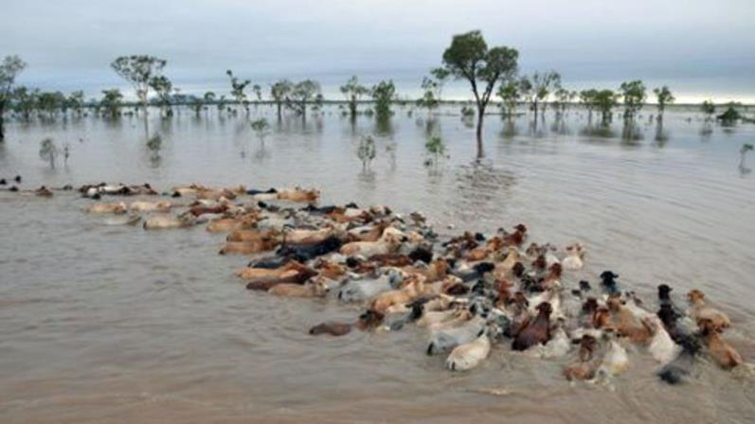
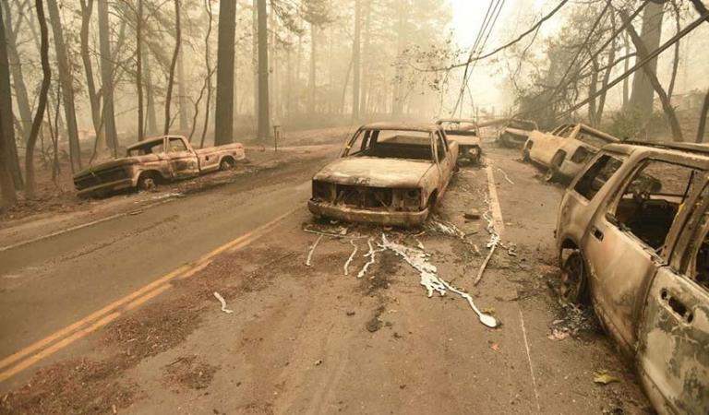
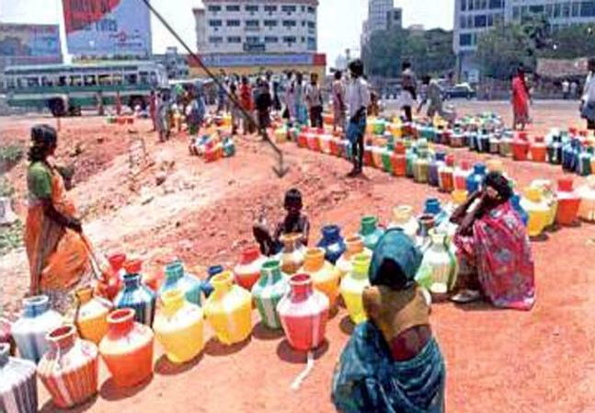
A hot Earth has more storms, droughts, floods and wildfires
Notes:
This amount of temperature change doesn't sound like all that much but it actually has surprisingly large effects.
To help get this in perspective, consider that when the Earth was last 4 degrees colder than today – and 4 degrees doesn’t seem like a lot either – we were in an ice age and the place that is now New York was buried under thick ice. So small changes in average planetary temperature produce large changes in actual living conditions.
When the Earth warms, large changes happen too. There is a lot more energy in the atmosphere and so it is a lot more active, with huge storms, like the hurricane that destroyed Puerto Rico in 2017, or the cyclone in this slide [top left] that struck Mozambique in 2019.
There is a lot more moisture in warm air and so some places experience much higher rainfall with flooding. On this slide [top right] you can see a huge flood in Australia in 2018 that killed half a million cows.
In regions that are naturally dry, as the air gets hotter then trees dry out and can burn in huge wildfires [bottom left] , like the ones we have seen recently in California and Australia, and also near the North Pole! Not only do these fires destroy people’s homes and sometimes kill people, they also destroy huge amounts of wildlife. And when trees burn, then they release CO₂ into the air.
As the Earth gets hotter we also see that less water becomes available in some regions. Sometimes this is because there is less rainfall and sometimes it is also because the glaciers that supply the rivers are melting and receding. This photo [bottom right] shows what happened recently in the Indian city of Chennai, when the city ran out of water completely and people had to queue in fierce heat (the extreme peak of the summer was 50C!) to get water that had been delivered by tanker. It has been suggested that in the not-too-distant future, we face a major war breaking out somewhere in the world over access to water.
Info
The aftermath of cyclone Idai: https://edition.cnn.com/2019/03/26/africa/mozambique-drone-footage-cyclone-idai-intl/index.html It was followed a month later by cyclone Kenneth: https://www.bbc.co.uk/news/av/world-africa-48081592/cyclone-kenneth-wipes-out-mozambique-villages
Floods following a Feb. 2019 deluge in Queensland, Australia, in which 500 000 cattle are estimated to have died https://www.bbc.co.uk/news/world-australia-47274662
People in the Indian city of Chennai, queuing for water delivered by tanker after a drought caused the city’s water supply to dry up https://edition.cnn.com/2019/07/12/india/india-chennai-water-crisis-train-intl/index.html
The aftermath of the California wildfires of 2018: https://www.wikiwand.com/en/2018_California_wildfires
https://www.weforum.org/agenda/2018/10/where-the-water-wars-of-the-future-will-be-fought

Slide 19
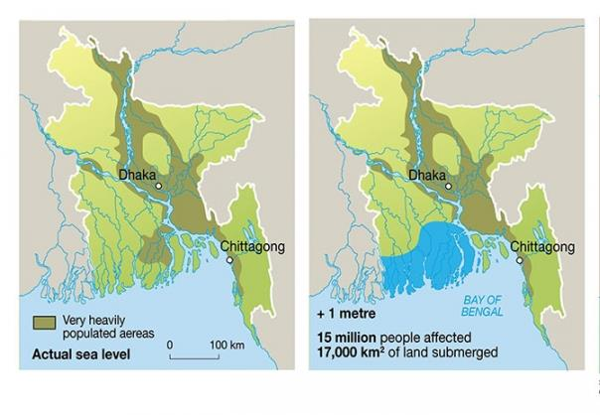
A hot Earth also has less ice and higher sea levels
Bangladesh by ~2100 will lose much of its land
Notes:
Another reason to worry abut the Earth getting hotter is that as it does so, ice melts, particularly at the poles. The pictures on the left show how much ice has been lost from the Arctic in the 28 years between 1984 and 2012.
This melting ice adds water to the oceans and can raise their levels considerably. It has been predicted that at the current rate of warming, the sea level will be around 1m higher than it is now by the end of the century. 1m doesn’t sound like a lot if you live on a hill, but in fact there are many areas of the world where people live are within a metre of sea level. The picture on the right shows that vast areas of Bangladesh, which is a very low-lying country, will be largely underwater by 2100.

Slide 20
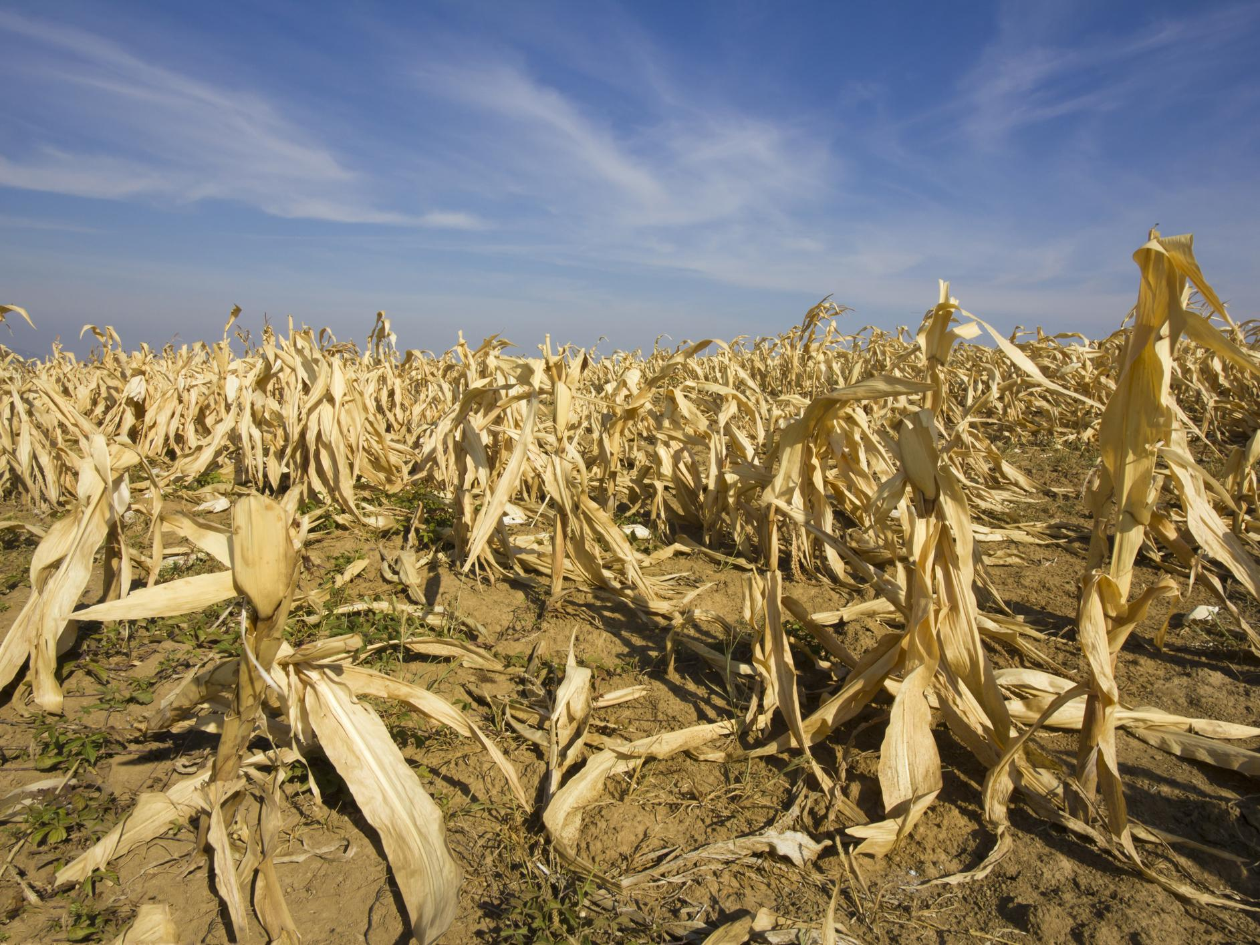
Crops don’t flourish
Notes:
Another concern about a heating world is that crops don’t grow well when conditions are hot and arid. Think of the Middle East or North Africa or central Australia, where very little grows. As the Earth warms, more regions that currently grow crops will become too hot and dry for that, and even in cooler regions, farmers may need to switch to growing produce that is more heat-adapted but perhaps less profitable. This will weaken the economies of many countries, and there may even be food shortages.

Slide 21
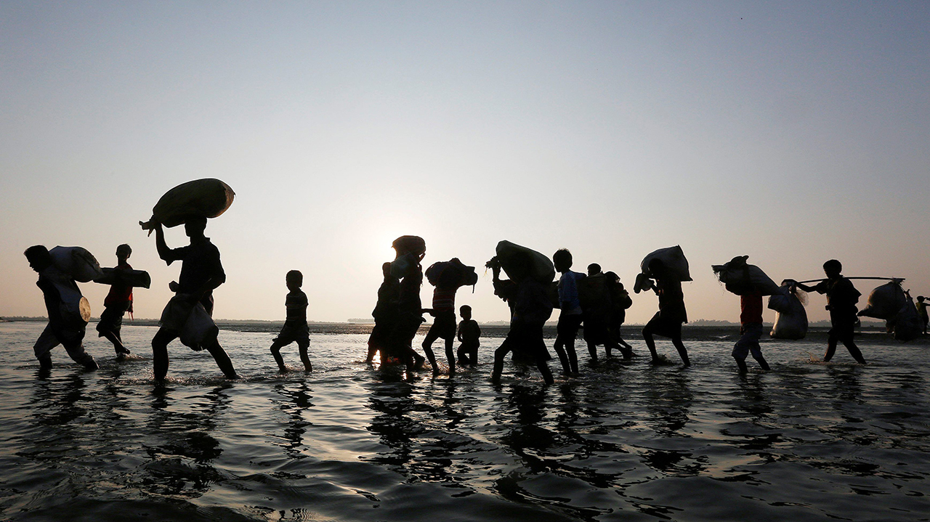
Some parts of the world become hard to live in and people are forced to leave their homes
Notes:
It is clear that as the Earth warms, some regions of the Earth will become essentially uninhabitable. Every country that has coastal towns and cities will be affected by sea-level rise, and the people who live in those regions will lose their homes and will have to move inland. Similarly, in farmed regions that have become too hot to grow things, people will need to move. Some people think this has already been happening: for example, the Syria crisis followed a prolonged period of drought which forced farmers to move to the cities. These types of conflict are very complex and it is impossible to find a single cause, but climate change is what some call a “threat multiplier” – it worsens other trouble-causing factors, making conflict more likely.

Slide 22
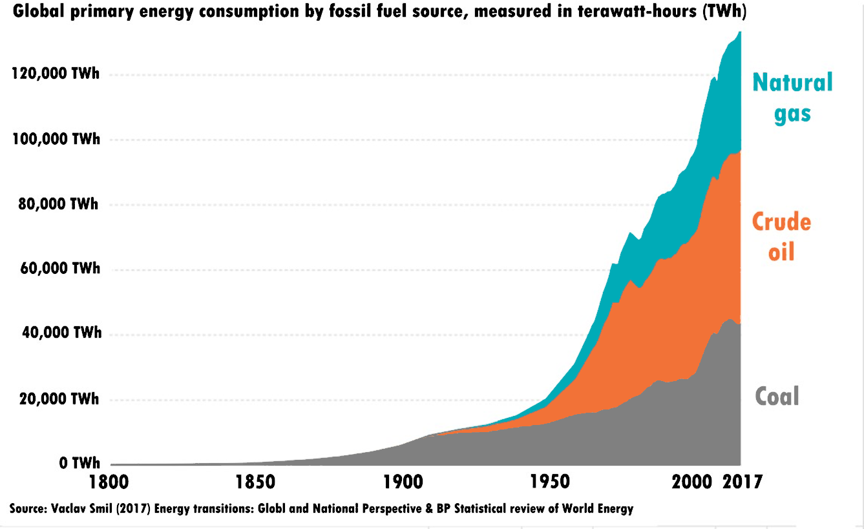
Although we have known about these problems for 40 years, we are burning ever-more fossil fuels
Notes:
[Could be hidden if time is tight – right click on the slide in the summary at the left and select “hide slide”]
It was 1988 when governments first woke up to the scale of the greenhouse effect problem, and efforts began to try and reduce our dependence on fossil fuels, by developing renewable energy technologies such as solar panels and wind farms. However, economies grew faster than these technologies did and so fossil fuel use has continued to skyrocket with no apparent sign of slowing down.

Slide 23

Now let’s look at ecology
We are not alone: we are part of a rich collection of living things on the Earth
We depend on these other living things for our air, food and quality of life
Notes:
As mentioned at the beginning, our life on Earth doesn’t depend just on climate but also on what we are doing to the other plants and animals that we share the planet with. Some people consider that these other living things have a right to live here too – but in any case, whether or they have a right to it, we depend on them. Ultimately our food comes from living things, and we need a healthy ecosystem to continue to provide us with the abundance of food we need to support our large and growing population.
The other thing is that these living things help regulate the atmosphere. In particular, plants control how much CO₂ is in the air – this is true not just for land plants like trees, but also microscopic ocean organisms called phytoplankton which form the base of many food webs and help the oceans absorb much CO₂.
Info
Winder, M. & Sommer, U. Phytoplankton response to a changing climate. Hydrobiologia 698, 5–16 (2012).

Slide 24
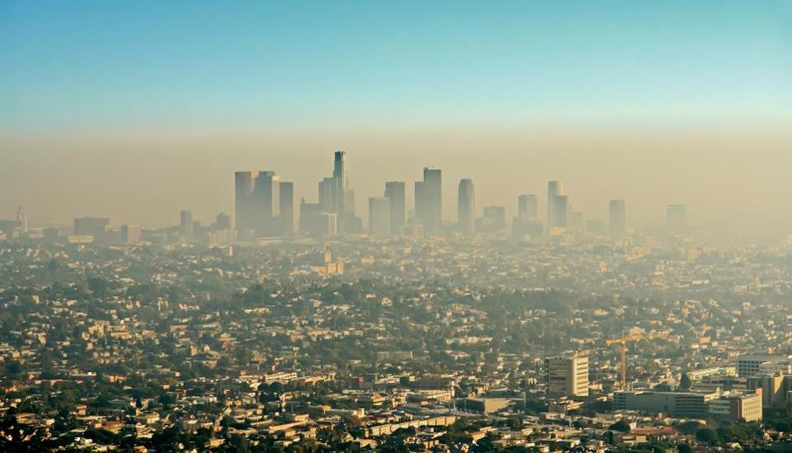
Our cities are destroying wilderness and polluting land, sea and air
Notes:
We are making very damaging changes to the surface of the planet which make it hard for wildlife to co-exist with us. Our cities are sprawling across the landscape and so are the connections between cities – roads – which make it hard for wild animals to move around. And of course, our cities produce vast amounts of pollution.

Slide 25
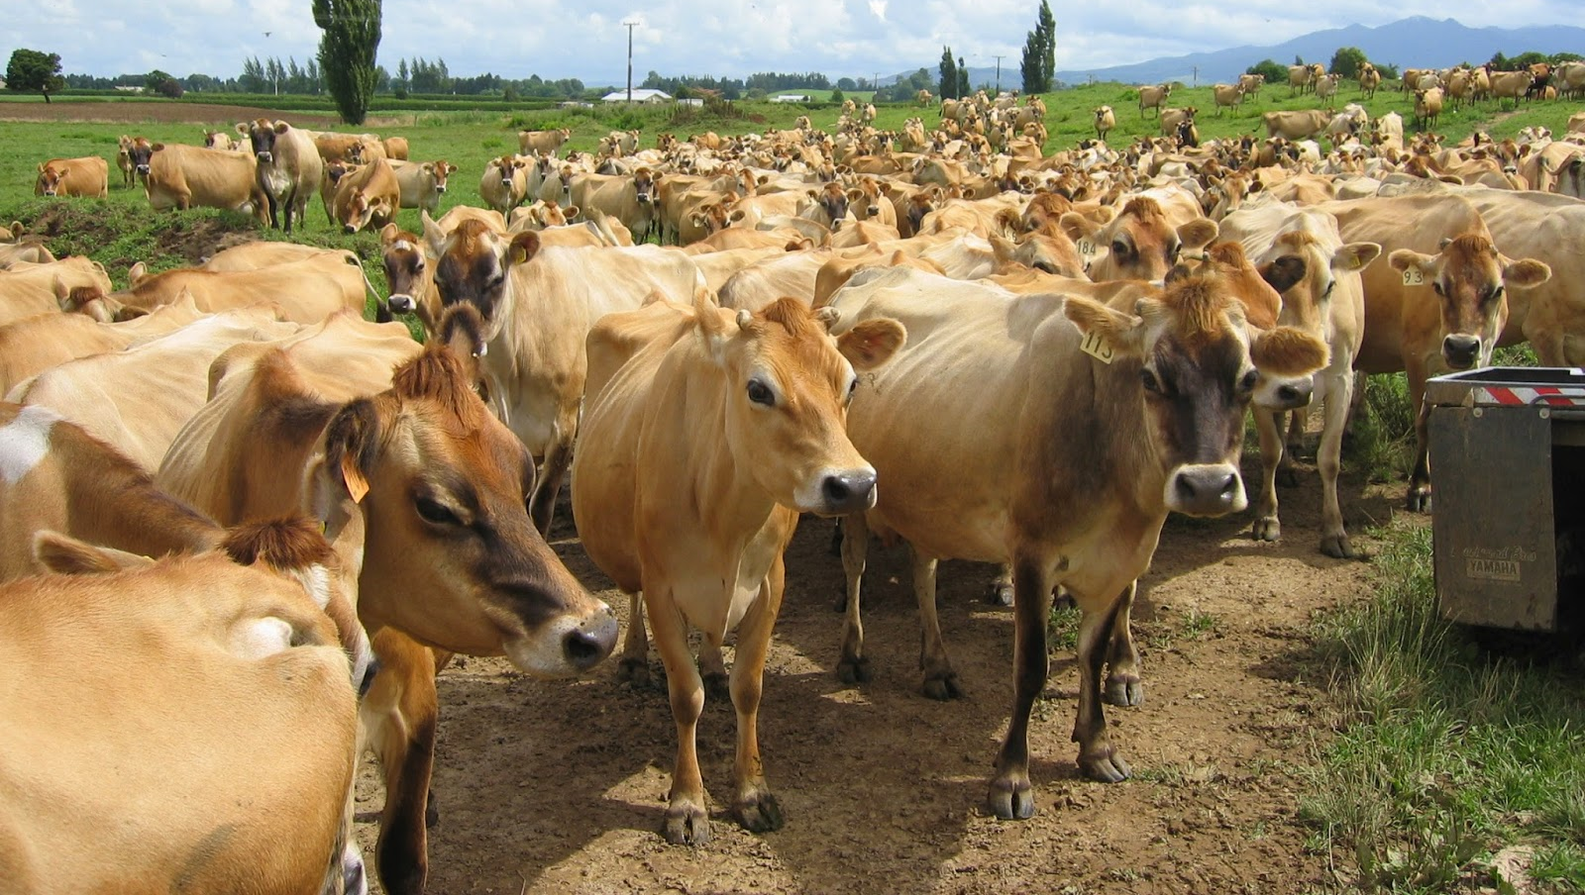
High intensity agriculture destroys ecosystems and produces warming greenhouse gases such as CO₂ and methane
Notes:
It’s not just cities that are damaging the planet’s ecosystems – farms are too. We need to use large amounts of land and water to grow our crops and feed our livestock. Meat requires ten times as much land as plants do to produce the same number of calories. Also, one of our most popular meat animals, cows, produce huge amounts of methane as they digest grass – this methane is a strong greenhouse gas (much stronger than CO₂) and means that cattle farming is one of the most damaging industries for climate.

Slide 26
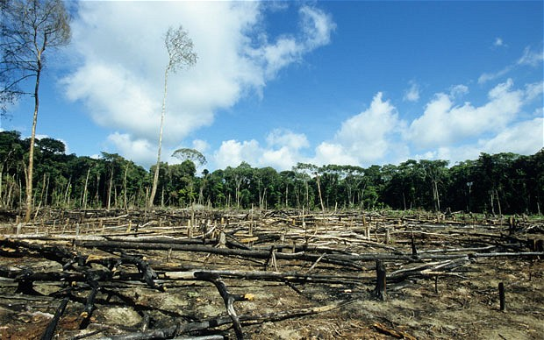
To make room for all this we destroy vast stretches of forest
Notes:
To make room for farms and factories we burn forests – this has the effect of destroying the habitats of vast numbers of creatures, large and small. It also means that more CO₂ goes into the air, partly from burning and partly from the reduced CO₂ absorption of grass compared with forest. Also, forests retain moisture in the environment – this is partly why it rains more over thick forest in the tropics. If forests are cut or burned then there is a risk that the land could become grassland and then desert.

Slide 27
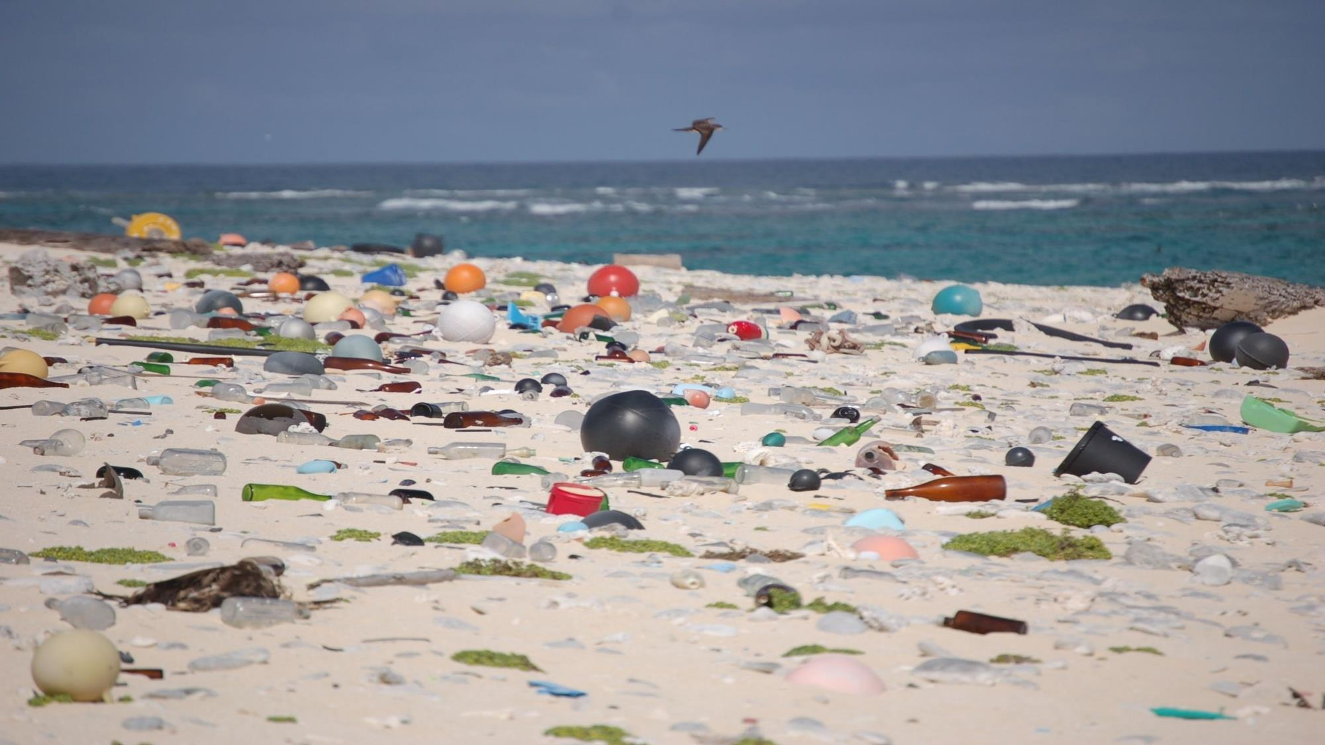
We are also covering the earth in plastic and toxic waste
Notes:
[Could be hidden if time is tight – right click on the slide in the summary at the left and select “hide slide”]
Another problem is that another use of fossil fuels, as well as burning, is that they can be used to make plastic. On the face of it plastic seems wonderful – it is lightweight, non-toxic, can be made in many shapes and colours, and it lasts for a long time. Unfortunately we are finding that its long life means that it accumulates as waste in the environment and it is starting to choke our oceans, waterways and land. This is having a damaging effect on wildlife, and as the plastics break down into tiny particles they start to get eaten and then find their way into the food web.

Slide 28
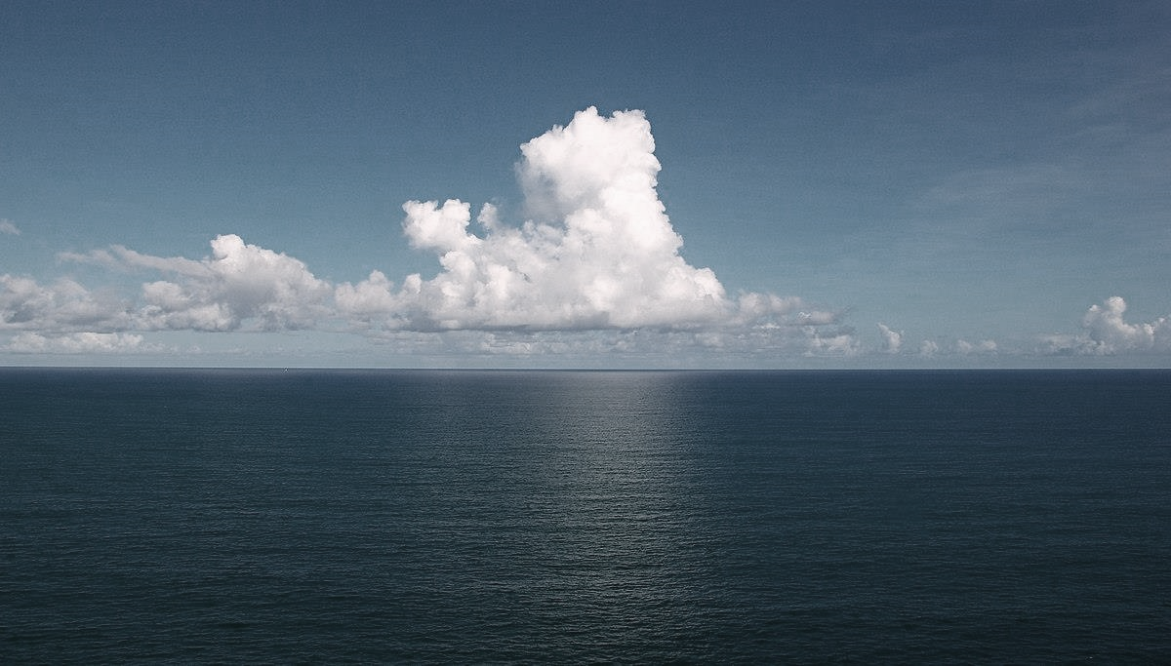
Oceans are equally vital to our survival
Oceans regulate the atmosphere and supply much of our food
Notes:
Oceans are just as important for us as land – oceans help regulate the climate, the balance of gases in the atmosphere and the organisms that support our food supply. Much of our protein comes form ocean sources for example.

Slide 29
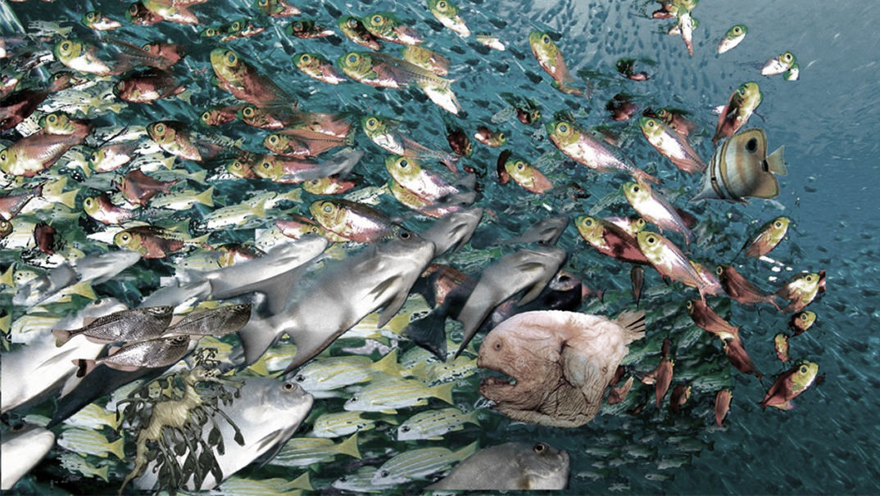
We are emptying the oceans of fish
Notes:
As we have become better and more efficient at harvesting fish, using huge ships with huge nets, we are starting to empty the oceans of fish. This has meant that species that were once abundant, like cod, are being driven to the brink of extinction, and there is a risk that they will actually go extinct which means, of course, that we will never get them back.

Slide 30
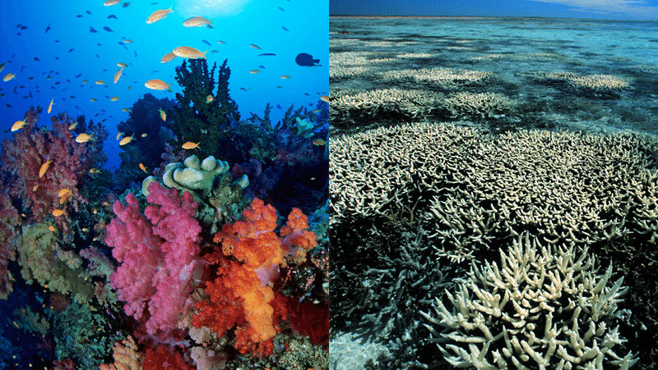
CO₂ acidifies the oceans and warm water destroys corals
Notes:
Another problem with the oceans is that as CO₂ levels in the air rise, more CO₂ dissolves in the oceans to form carbonic acid. This makes the oceans slightly less alkaline than they normally are, a process called “acidification”. This has the effect of harming many creatures, for example by dissolving the shells of shellfish and corals. Ocean heating also causes coral “bleaching” which is a reaction to stress, and means that the reefs die, along with the many creatures that live there.
Info
Fabry, V. J., Seibel, B. A., Feely, R. A. & Orr, J. C. Impacts of ocean acidification on marine fauna and ecosystem processes. ICES J. Mar. Sci. 65, 414–432 (2008).
Coral reef loss http://www.worldwatch.org/node/5960

Slide 31
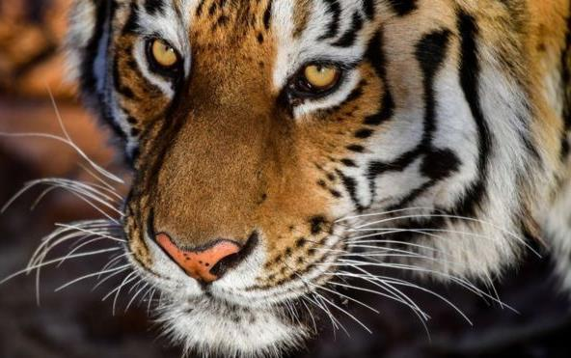
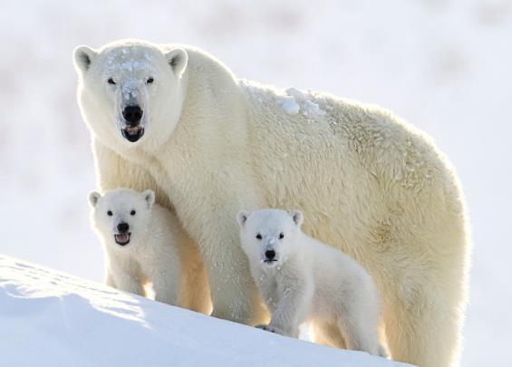
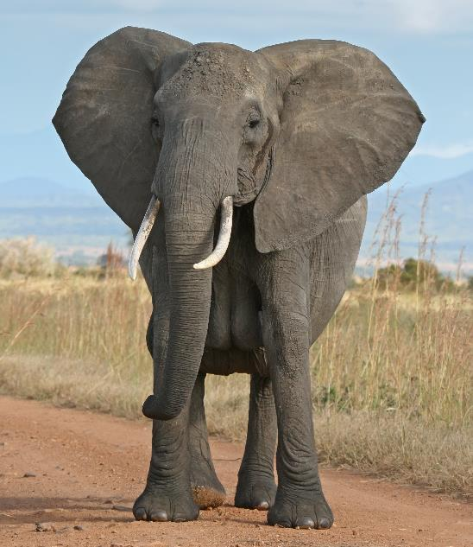
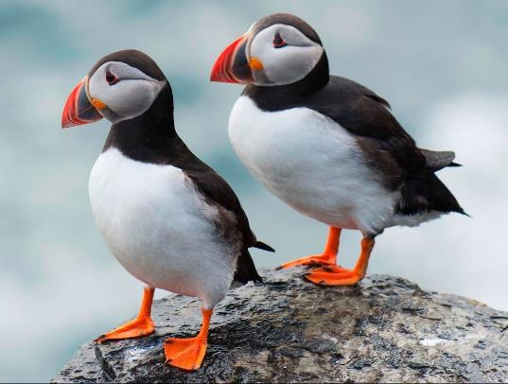
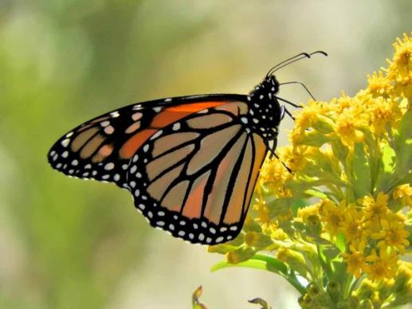
We are bringing wildlife to the brink of extinction
Notes:
Putting all this together, it is clear that our business as usual” way of life is bringing many creatures on Earth to the brink of extinction. The question is whether we care enough to take action to stop them from actually becoming extinct.
Info
IPBES webpage https://www.ipbes.net/
IPBES Q&A https://www.ipbes.net/news/million-threatened-species-thirteen-questions-answers

Slide 32
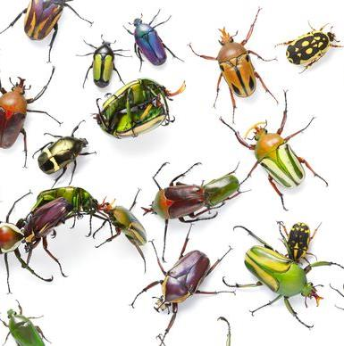
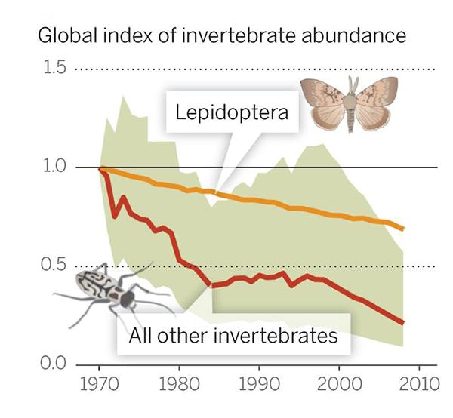
Bug populations are plummeting due to pesticide use
Notes:
It isn’t just large animals that are under threat – bugs are too. Bugs are invertebrates – little creatures such as bees, wasps, flies, spiders etc that work away in the background keeping ecosystems healthy – they scavenge dead material for example and return it to the soil, or they pollinate flowers. In recent years we have seen a huge fall in the number of insects, mainly because of large-scale pesticide use by farmers who are trying to grow crops. This is becoming very noticeable to us now. For example, a few decades ago, your parents might remember that if you drove anywhere in the countryside for a while you would need to stop to scrape dead bugs off the windscreen. In summer, if you left the windows open and the lights on then the room would fill up with moths. These days, these things don’t happen any more. Many children barely see a bug and don’t realise how important these little creatures are for our well-being.
Info
Sánchez-bayo F, Wyckhuys KAG (2019) Worldwide decline of the entomofauna : A review of its drivers. Biol Conserv 232:8–27.

Slide 33
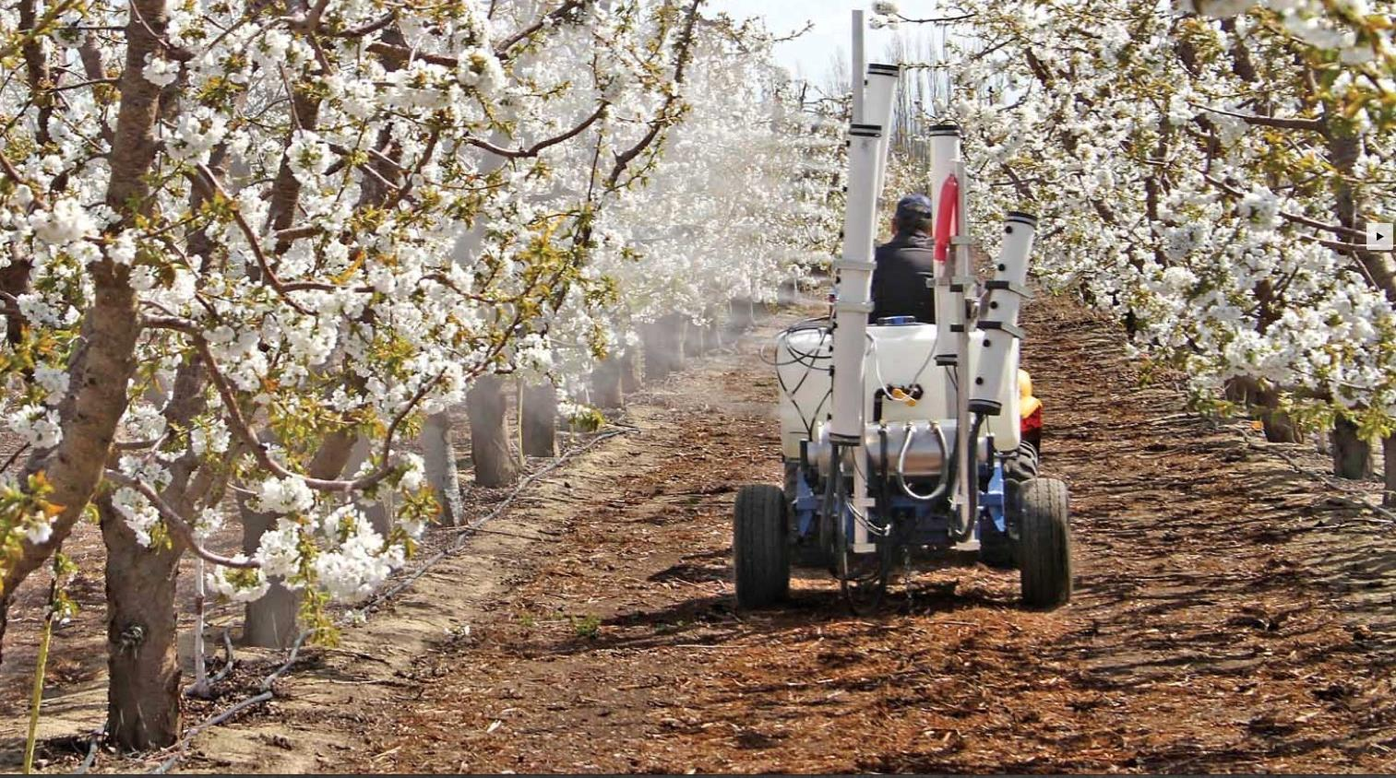
These days many fruit growers need to pollinate trees artificially
Notes:
[Could be hidden if time is tight – right click on the slide in the summary at the left and select “hide slide”]
Insect pollination is important for the health and reproduction of many types of plants, including ones that we depend on for food. In many parts of the world, including the US and China, there are no longer enough insect pollinators around to ensure a healthy growth of fruit crops and so growers are having to transport bees around by truck, or use artificial machines or even pollinate the trees by hand.

Slide 34
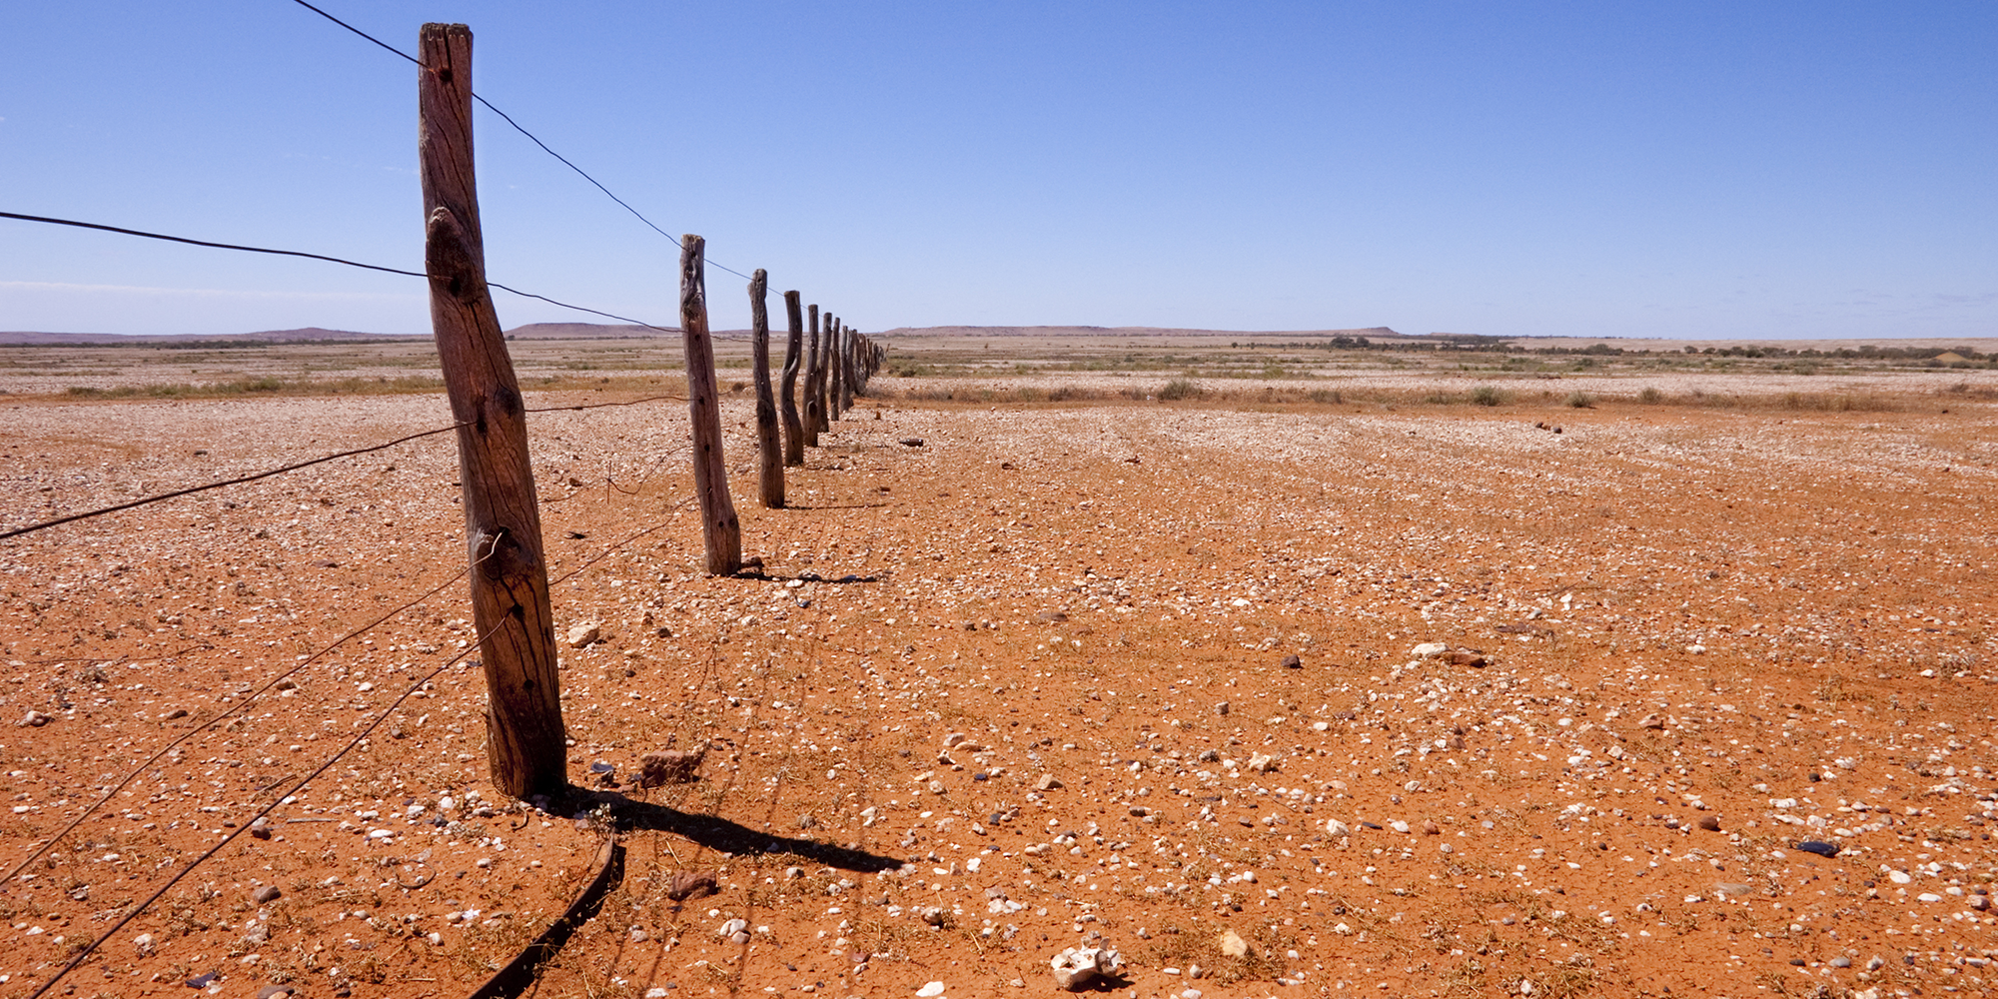
The worry is that climate change and ecological destruction together may make the Earth inhospitable for humanity
Notes:
If you think about the combined effects of all these changes, then the worry is that if we don’t take action to stop all this, we are headed for an uncertain future where we cannot live comfortably, or – in the worst case scenario – even at all.

Slide 35

NEXT:
WHAT
CAN WE
DO?!
Notes:
In the next part of the talk we will look at what we can do to make our future secure and keep our planet healthy. First, though, we will pause for a break so that you can think about what you have heard, and then talk to your neighbor about it …

Slide 36

First: break & talk to neighbour about what you have just heard
How does it make you feel?
What do you think we should do?

Slide 37
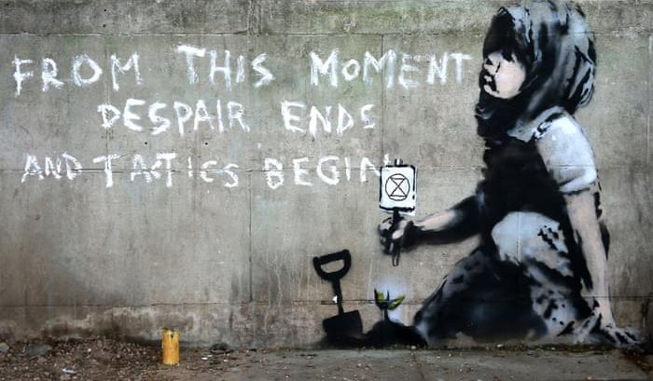
PART 2
WHAT WE NEED TO DO
Notes:
In this second part, we will look at what we can do to stop the decline of our planet and protect its future.

Slide 38
WE NEED TO
GET EVERYONE WORKING TOGETHER
TO SOLVE THIS
Notes:
One thing that is really clear from the scale of this problem is that none of us can solve it by ourselves. We need action to be global, and for that we need the help of our governments, whose job it is to keep things running well so that we remain safe and prosperous. When it comes to the planetary crisis, governments have not been sufficiently active, or at least their actions have not been successful. However, it is not too late to take the action we need to prevent further warming and to try to restore damaged ecosystems. In this part of the talk we will look at what needs to be done, and think about how to achieve this.

Slide 39
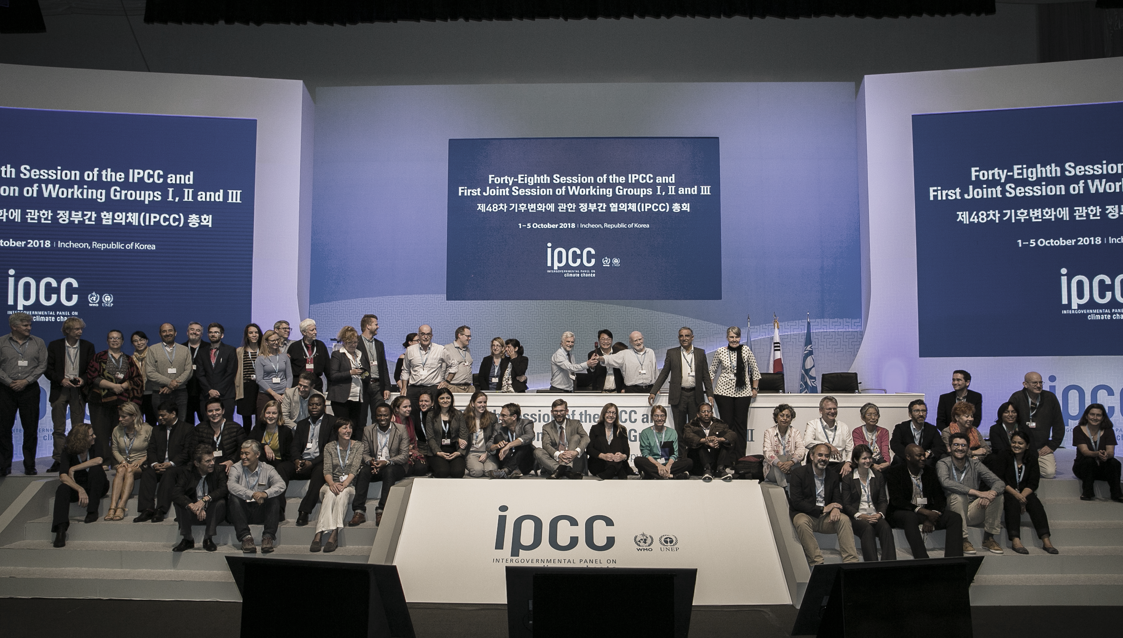
World governments have set scientists onto studying the problem
Notes:
Governments have actually been trying to address the fossil fuel problem – in 1988 they formed a global organisation called the Intergovernmental Panel on Climate Change (IPCC) whose job is to evaluate all the scientific literature and come to a conclusion about what is happening, so that governments can decide what to do.
The IPCC issues very detailed reports every few years, and the reports have been very clear about the growing effect of greenhouse gas emissions, the likely consequences if they continue, and the speed and scale of the problem.

Slide 40

Because of the IPCC warnings there have been several attempts to get world agreement to stop fossil fuel use
Several global climate summits over several decades
• Rio • Kyoto • Paris
Notes:
Governments have listened to the IPCC and have tried to get together to agree a plan of action, but the plans have not worked. The most recent agreement is called the Paris Climate Accord, made in 2015. In it, governments tried to agree to keep the warming of the Earth to 1.5C above the “preindustrial baseline” (that is, to what it was before the Industrial Revolution). At 1.5C, they predict that there will be an increase in floods and droughts and there will be a rise in sea level, but that we will be able to manage most of the effects.
This plan failed as soon as it began, because governments ended up agreeing not to 1.5C but to 2C, saying only that they would “pursue efforts to limit warming to 1.5C” which seems to admit already that 1.5C is not going to be possible. At 2C, impacts will be much greater than at 1.5C and many people will be harmed.
Even 2C is starting to seem unlikely, and the IPCC thinks we are on track to 3 or even 4C if things carry on as they are at the moment.
Info
IPCC special report on the impacts of global warming of 1.5 °C above pre-industrial levels https://www.ipcc.ch/sr15/

Slide 41

People have also tried local action in individual countries
• Political • Legal • Campaigning • Individual action
Notes:
The second thing people have tried is to take actions within their own countries by protesting to their own governments with demonstrations and marches, or by trying to get individuals to change their own lifestyles. Several organisations have been working very hard to make such changes – you may have heard of Greenpeace and Friends of the Earth. Sadly, these organisations have had relatively little effect – some people have listened, and changed the way they live, but nowhere near enough.

Slide 42
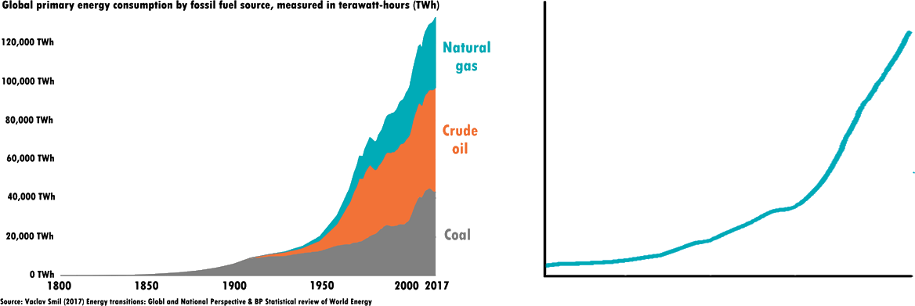
Sadly, none of it has worked
1.6
1.4
Annual atmospheric greenhouse gas index
1.2
1.0
0.8
0.6
0.4
0.2
0
1800
1850
1900
1950
2000
Adapted from: https://www.esrl.noaa.gov/gmd/ccgg/aggi.html
Notes:
None of this has worked – fossil fuel use and atmospheric CO₂ continue to head steeply upwards.

Slide 43



Why hasn’t anything worked?
One problem is our fossil fuel economy, which is how we run our lives
Notes:
Why hasn’t this all worked? One reason is that we are addicted to fossil fuels. We use them in almost everything we do from cooking our food and heating our homes, to going on holiday. It is very hard to imagine what our lives would look like if we decarbonised, and yet that is exactly what we need to do. Think about your own life, and what you would need to do to stop using fossil fuels – not just directly, but indirectly in the things you buy.

Slide 44
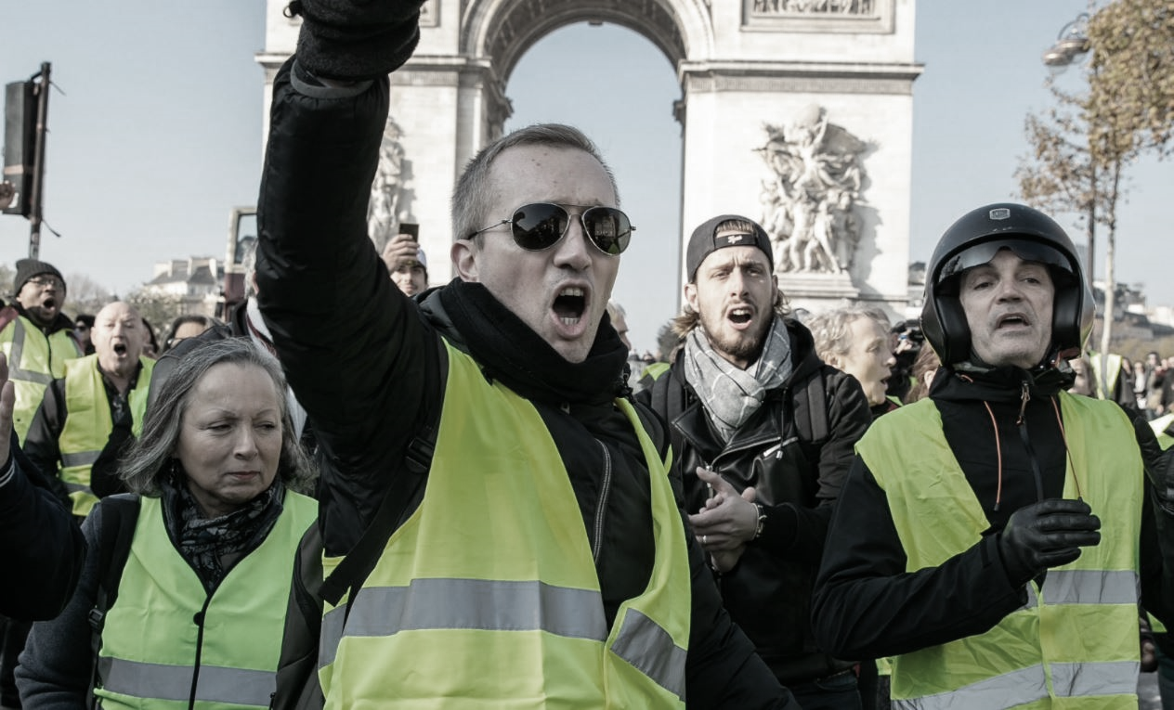
Why hasn’t anything worked?
Another problem is that governments know that people may be angry if fossil fuels are made unavailable
Notes:
Another problem is that efforts to reduce fossil fuels affect some people more than others, and often it has the worst effects on people who don’t have very much money. A rise in fuel prices for example can be very hard for someone who has a low-paid driving job. This has meant that attempts to limit fossil fuels, such as closing coal mines or raising the price of fuel, have caused a huge backlash from people.
To take a recent example: in France, when President Macron tried to raise fuel prices by taxing them, a violent popular uprising began – the “Gilets Jaunes” (Yellow Vests) – see the angry demonstration in the photo. Governments suspect, probably rightly, that people won’t vote for them if they make it expensive to use fossil fuels. Although people can see that in the long term these fuels are harmful, in the short term they rely on them for their livelihoods.

Slide 45
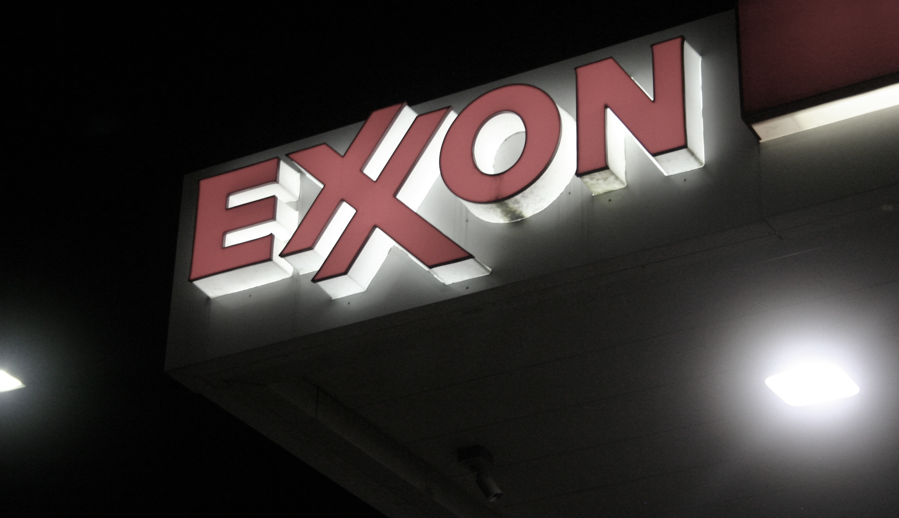
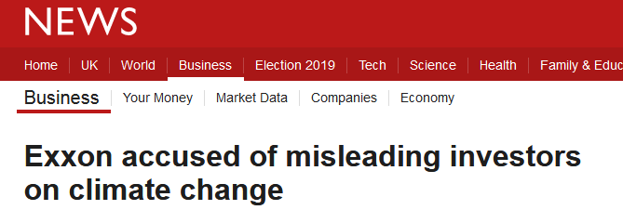
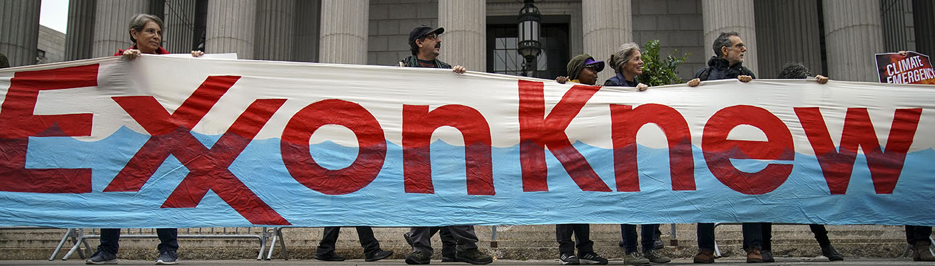
Fossil fuel companies, like tobacco companies before them, have promoted their products, hidden the truth about their harms and paid governments to support them
Why hasn’t anything worked?
Notes:
[Could be hidden if time is tight – right click on the slide in the summary at the left and select “hide slide”]
Another problem has been that – very much like the tobacco companies before them – fossil fuel companies have mounted a very strong campaign to prevent the public from learning about the facts of the harms caused by their products. They have helped to foster so-called “climate denialism” which means that a lot of people don’t believe that climate is actually changing, or if they do, they don’t think it’s because of fossil fuels.
Info
Merchants of Doubt: How a Handful of Scientists Obscured the Truth on Issues from Tobacco Smoke to Global Warming Naomi Oreskes and Erik Conway

Slide 46


WE NEED A
NEW
APPROACH
Notes:
So we need to take a new approach.

Slide 47
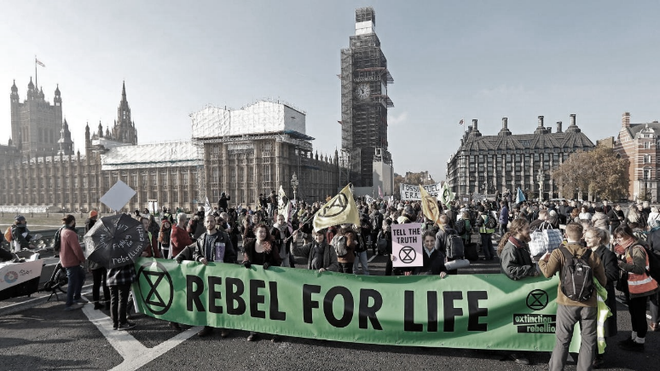
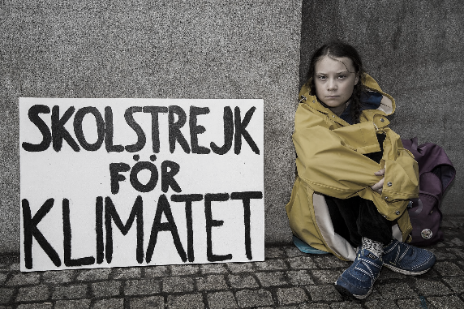
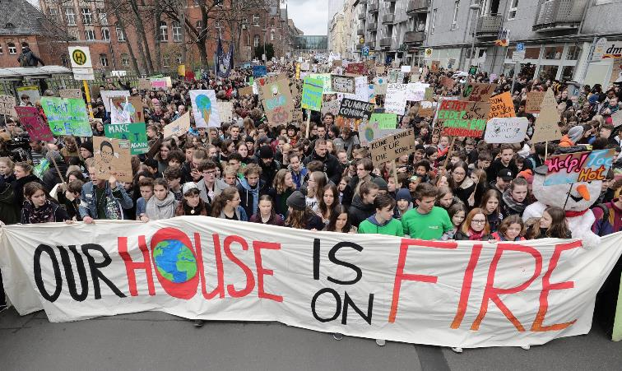
In 2018, something new happened: citizens started rising up
Notes:
Indeed, something new has started to happen, around the world.
2018 was a year that saw a large number of freak weather events including an extremely hot summer in Europe, wildfires in California, cyclones in Mozambique etc. and at around this time, citizens across the world started forming organized protest movements. One movement is “Fridays for Future”, started by the Swedish school student Greta Thunberg, which has spread across the world and now involves hundreds of thousands of young people, who skip school on Fridays to protest at the way their future is not being carefully protected.

Slide 48
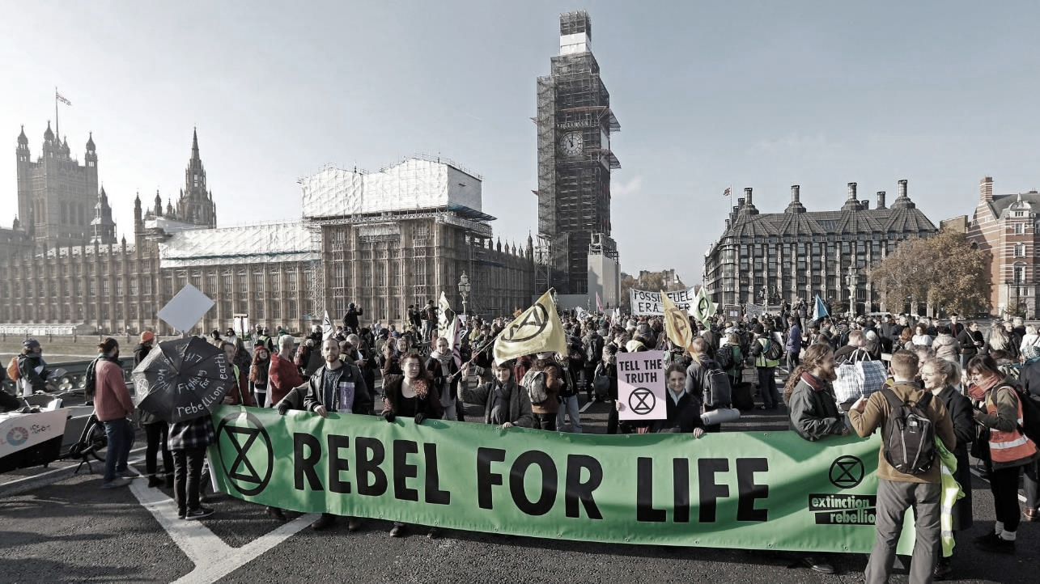

Extinction Rebellion is one of these new groups
We use disruption to get attention
Notes:
Another one is our organization, Extinction Rebellion, which is an organisation that uses non-violent direct action (NVDA) to raise awareness and to put pressure on governments to take action.
It first came to prominence when it issued a “Declaration of Rebellion” in October 2018, and followed this with an attention-grabbing demonstration in central London that blocked the five main bridges and created a lot of media interest.
It then mounted a big London demonstration in April, called the “April Rebellion”, occupying several sites around London including Oxford Circus, Waterloo Bridge, Parliament Square and Marble Arch.
As well as several smaller actions there was another big demonstration in London in October, the “October Uprising.”
All of these activities have made extinction rebellion one of the fastest-growing movements ever, and it now has a global reach, and is having a big impact on the public discussion of climate change.

Slide 49

Our three demands
Tell the truth about the ecological crisis and declare a climate emergency
Greenhouse gas net-zero & halting of biodiversity loss by 2025
Citizens’ assembly on climate and ecological justice
Notes:
Extinction Rebellion (XR) has three demands:
That the government and media should report fully and completely on the climate and ecological emergency so that the general public know what is going on
That greenhouse gas emissions should be reduced to net-zero (“net” means that the amount that is produced is balanced by the amount that is taken from the air again – for example by planting trees – so that the overall gain increase becomes zero) – and also that we should cease the destruction of ecosystems and stop further species sliding towards extinction
That the government should set up a citizens’ assembly, which is a group of ordinary people that are asked to weigh evidence and make decisions about an issue.

Slide 50
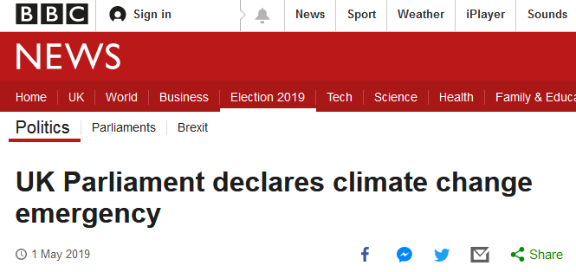
Demand #1: Shortly after our “April Rebellion” parliament declared a climate emergency
Notes:
Since Extinction Rebellion began, there has been a change: the media have started talking about the climate and ecological crisis, and parliament declared a “climate emergency” shortly after the April Rebellion.

Slide 51
Demand #2 2025 means “act immediately”
Government target of 2050 is based on the assumption of non-existent “negative emissions technologies”
2050 is too far away (30 years) to motivate politicians to take the strong action needed NOW
People are dying now and so we need full-scale action now. We cannot delay.
Notes:
People often ask about the second demand – why 2025 in particular? The government’s target is 2050, which came out of the Paris Agreement, but as we saw earlier, that agreement was already quite watered-down. In any case the government have not taken any significant steps towards reaching the 2050 target either. And also, the 2050 date assumed that some type of “negative emissions” technology would come along to reduce atmospheric CO₂ – that hasn’t happened, and doesn’t seem likely.
Extinction Rebellion’s view is that we must act as soon as possible and as fast as possible so we aim to put maximum pressure on the very next parliament.

Slide 52

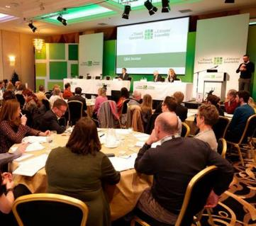
Demand #3: Why do we want a citizens’ assembly?
● Can take the long view
● Free from corporate influences
● Truly representative of the population
● Trusted by the public
● Has been effective before (Ireland, Poland)
Notes:
The reason for demand 3 – a Citizens’ assembly – is the one mentioned earlier about governments not having the power to force an unwilling populace to accept damaging laws and regulations, because they will get voted out. By making these decisions be the decisions of the people rather than of the governments themselves, they don’t risk their elections, and people are more likely to trust the decisions. Citizens assemblies have worked well in the past – a good example is the Irish abortion law issue, where a Citizens’ assembly recommended liberalization of the laws: a decision the public then supported with a referendum.
The idea with decarbonizing the fossil fuel economy is that unpopular measures, such as raising fuel prices or removing agricultural subsidies, will be better supported if recommended by groups of people that included those who would be affected.

Slide 53

Extinction rebellion practicalities – how we work
Notes:
Let’s look a little bit at how Extinction rebellion works, because it works slightly differently from traditional organisations.

Slide 54


We are
NON-VIOLENT
Notes:
The most important thing about it is that it is, and always will be, non-violent. This makes it different from some other protest organisations, such as the Suffragettes, who sometimes used violence. Our position is that violence is unethical and also weakens our position, because authorities have a lot of methods for dealing with violent protest, but can be a little flummoxed by peaceful protest..

Slide 55
We are de-centralised and self-organising
Local groups
Affinity groups
Working groups
Coordinating groups
Notes:
The second important thing that makes us unusual is that we don’t have a central command. We are basically a huge network or small groups that work by coordinating their actions using the internet. This means that small groups can make decisions without needing permission from a higher authority, which allows them to be creative. Most groups have a similar internal structure which is that they have working groups – for example, Media and Messaging, or Action Planning, and they also have coordinating groups made from representatives of each of the working groups. This is also true at a national level – there is a national Media and Messaging group and national Action Planning group.

Slide 56
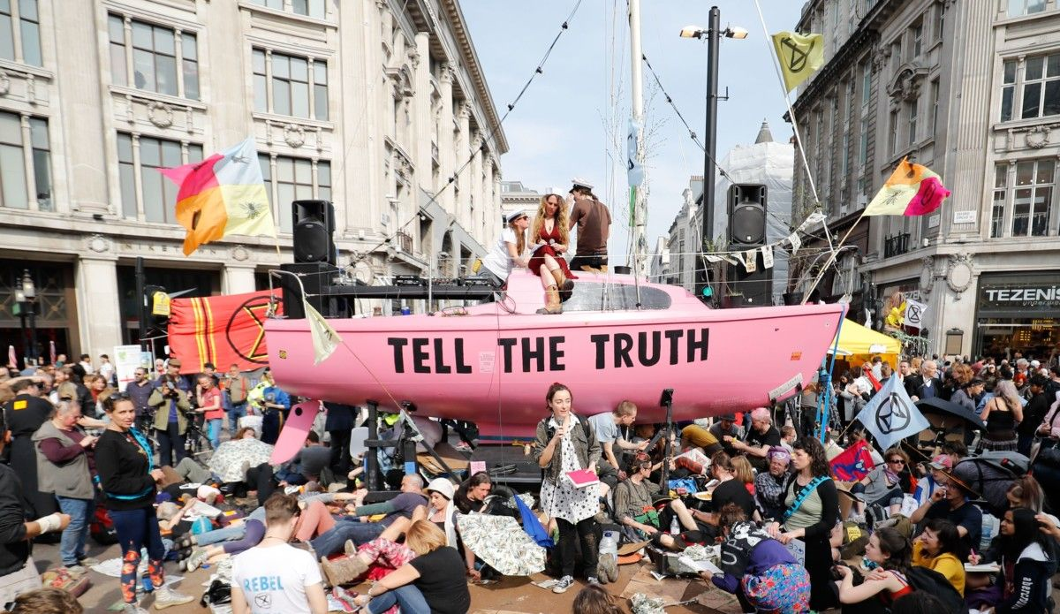

Our core activities are
ACTIONS
Notes:
The most obvious and notable thing about what we do is the actions we put on. Some of these are local and some of them are large national-level actions, usually in London. In these actions we try to create a significant but friendly disruption – the idea is to stop daily life from functioning normally so that people will need to take notice of what we are saying, and the media will report on what we do and raise the profile of our message.

Slide 57
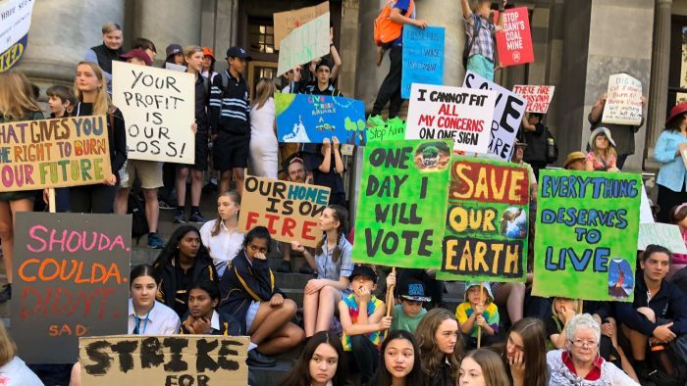

We aim to make governments worldwide listen to their people and take action on the planetary crisis
Notes:
The basic idea is to make governments listen to us.

Slide 58



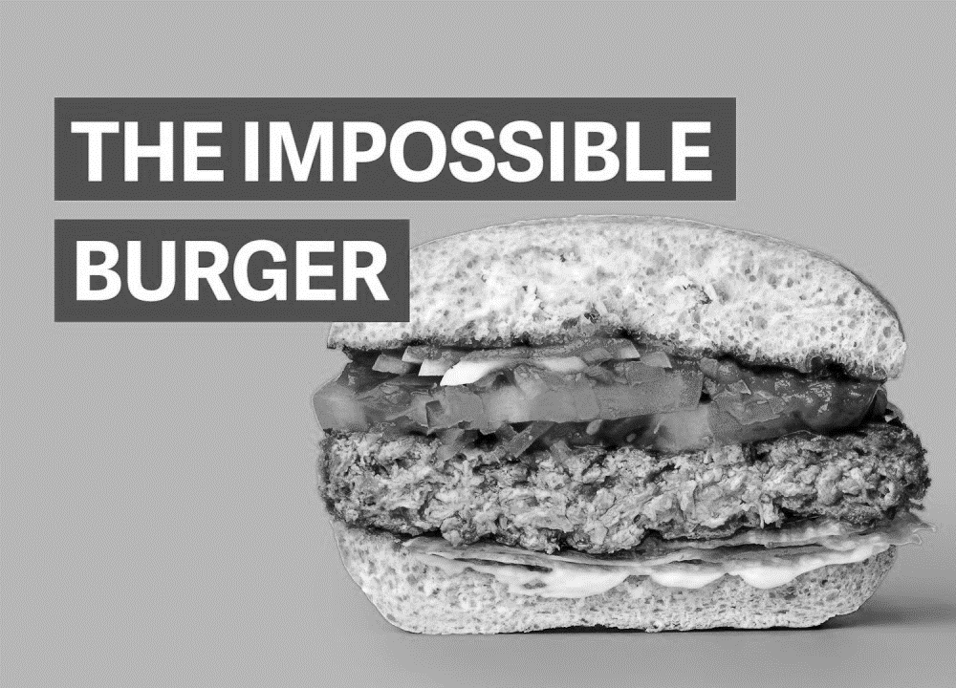
What can you do yourself?
Write to your MP:
MPs care about their voters
Make personal changes to your own lifestyle: it makes you feel better, and has a surprising influence on those around you!
Talk to your parents:
adults listen to their children!
Notes:
Although it is clear that the whole world needs to act on this crisis, people often feel they need to do something to help in their own lives. This is a good idea – as Greta Thunberg says, “No-one is too small to make a difference”. So, what can you do?
First – talk to your parents. Adults are slow to appreciate how fast the world is changing because they are used to things being a certain way and tend to think things will always be this way – they can’t so easily imagine change. However, adults care deeply about their children and if children start talking about things they might listen, in a way that they perhaps wouldn’t listen to other adults.
Second – write to your MP, and get your parents to write too! MPs care about their voters – “constituents” – and if a lot of people write in about the same issue then they start to take notice. MPs say that their constituents mainly care about local issues like potholes – so prove them wrong.
Third – make changes to your own carbon consumption – for example, by switching from a meat-based to a plant-based diet. Quite apart from anything else, making changes to your own life makes you feel better. But also, you have an affect on people around you and people start to copy each other, thinking “well if that person can do x then maybe at least I can do y” and soon the behaviour goes viral.
That’s ultimately what we need to do – make decarbonisation go viral.

Slide 59
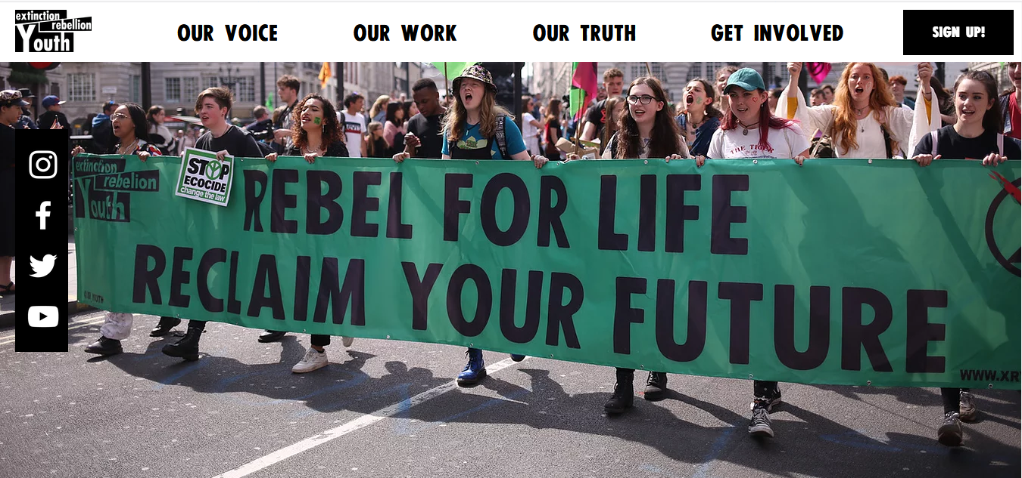
And you could join Extinction Rebellion Youth…
Notes:
And finally… think about joining us! Extinction Rebellion has a youth group that is very active and welcoming. Getting together with others who have similar concerns is very uplifting, and taking action gives a great sense of excitement and hope. A lot of small people acting together can make a large change. So don’t feel that you are helpless, you aren’t – as the adults of the future, the future is yours to help shape. Our planet is resilient – if we stop harming the Earth it will soon recover.

Slide 60


And you could join Extinction Rebellion Youth…
Fill out the form or visit
https://actionnetwork.org/forms/join-the-xr-youth-network-2
2. Join them on Facebook to find out when/where
their next meeting is
3. Offer your time (as little or as much as you want)
and share your skills
4. Make change happen!
Notes:
Here are the details about how to join.
Thank you for listening!

